Slide 1

Practical Lesson
EQ: How do we measure heart rate after resting and exercise?

Slide 2
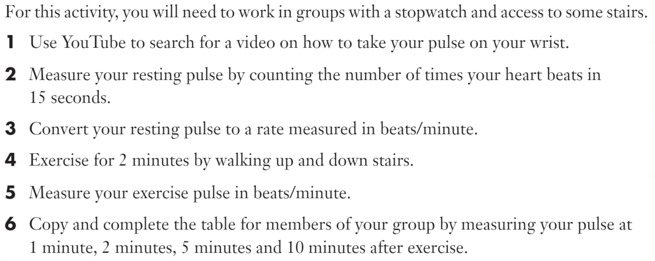

Slide 3
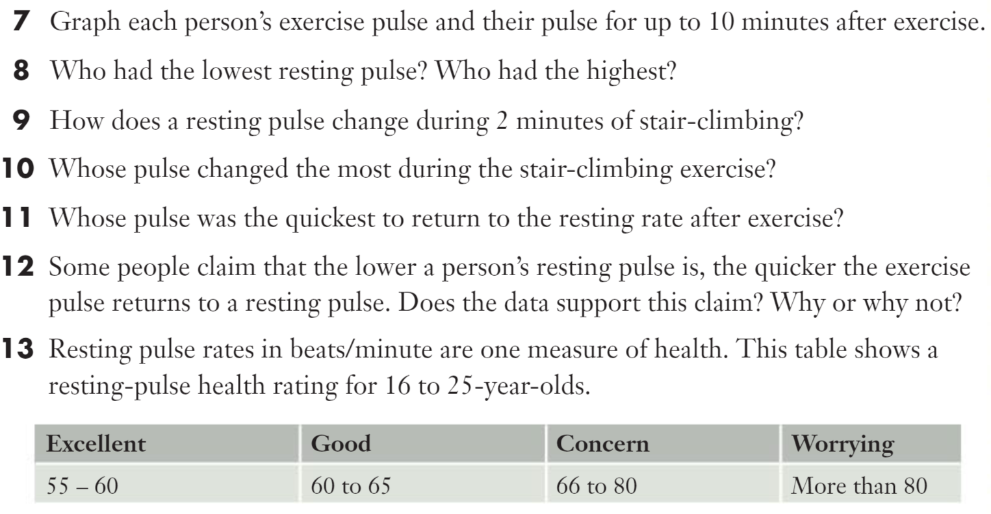

Slide 4
